Slide 1
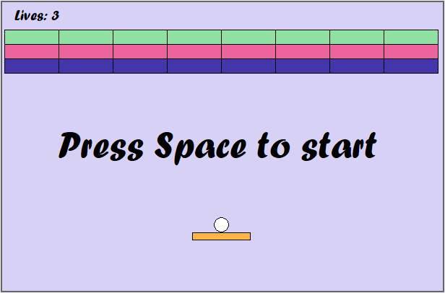
Brick breaker mini game

Slide 2

Step 1
We make it by using python libraries that call tkinter

Slide 3
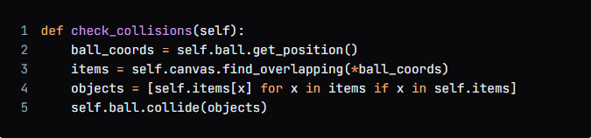
Step 2
Check collision method
ball_coords = self.ball.get_position(): Retrieves the current position of the ball.
items = self.canvas.find_overlapping(*ball_coords): Uses the find_overlapping method of the canvas to find all items that overlap with the ball's position. The * operator unpacks the ball_coords tuple into separate arguments.
objects = [self.items[x] for x in items if x in self.items]: Creates a list of objects that overlap with the ball. It filters the items list to only include items that are present in the self.items dictionary.
self.ball.collide(objects): Calls the collide method of the ball, passing the list of overlapping objects as an argument. This method is not shown in the provided code, but it likely handles the collision logic.

Slide 4
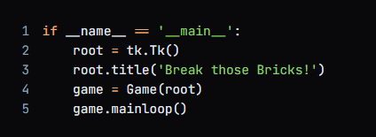
Step 3
Main game loop
if __name__ == '__main__':: This is a guard clause that ensures the code inside this block only runs when the script is executed directly (i.e., not when it's imported as a module by another script).
root = tk.Tk(): Creates a new Tkinter window (the root window).
root.title('Break those Bricks!'): Sets the title of the window.
game = Game(root): Creates a new instance of the Game class, passing the root window as an argument.
game.mainloop(): Starts the main event loop of the game. This method will block until the game window is closed

Slide 5
Thank you

